Slide 1


Artificial Intelligence Project
Team Details:
Mayank -2210990565
Mukund-2210990587
Mayank Tiwari-2210990570
Faculty Coordinator: Dr. Monica Dutta
:
Chitkara University Institute of Engineering and Technology,
Chitkara University, Punjab

Slide 2
Table of Contents
1. Introduction
2. Objective
3. Problem definition and Requirements
4. Methodology
5. Source Code
Result
7. Reference

Slide 3
Introduction
Object detection plays a critical role in computer vision applications such as surveillance, autonomous vehicles, and augmented reality.
YOLO (You Only Look Once) is a widely recognized algorithm renowned for its real-time object detection capabilities, distinguished by its speed and accuracy.
This project offers a practical demonstration of implementing YOLO for detecting objects within images.
By utilizing YOLO's efficiency, the project enables swift and precise identification of objects, enhancing subsequent analysis and decision-making processes.
Through this demonstration, viewers gain insight into the significance of YOLO in advancing object detection technology, fostering innovation across industries reliant on computer vision solutions.

Slide 4
Objective
1. Implement YOLOv3 to deliver real-time object detection capabilities, harnessing its inherent efficiency in processing entire images in a single pass.
2. Employ the COCO dataset for YOLOv3 pretraining, ensuring the model's proficiency in recognizing a wide spectrum of object classes across various scenarios.
3. Engineer Python scripts with intuitive interfaces, facilitating seamless configuration and execution of the object detection pipeline.
4. Enable interactive visualization features using Matplotlib, allowing users to comprehend and analyze detected objects through annotated bounding boxes and class labels.
5. Ensure scalability and modularity in the project's design, enabling easy customization and integration into different environments and workflows.

Slide 5
Problem Statements
Practical Application: Object detection has a wide range of applications in many areas such as security, self-driving cars, image recognition, etc. This project will provide a practical solution that can be adapted to solve real-world problems.
Learning Opportunity: Implementing YOLO will help in understanding the working of complex neural networks and their applications in computer vision. It provides a great opportunity to learn and understand deep learning concepts.
Performance Evaluation: This project will help in understanding how different factors affect the performance of the model. It will provide insights into the trade-off between speed and accuracy, and how to optimize neural networks for performance.
Customization: By building our own object detection model, we can customize it to our needs. We can train it to recognize objects that are of interest to us.

Slide 6
Methodologies
The methodology for developing the YOLOv3 Object Detection System involves several key steps. Firstly, the problem statement and project objectives are clearly defined, outlining the need for an efficient solution to accurately detect objects in images. A thorough literature review is conducted to understand existing object detection algorithms, with a focus on the strengths and limitations of YOLOv3. Next, datasets such as the COCO dataset are collected and prepared, including data preprocessing and annotation. The YOLOv3 algorithm is then implemented using libraries like OpenCV and NumPy, with the pre-trained model loaded and configured for object detection. Subsequently, the model is trained and evaluated on a validation set, with performance metrics assessed. Optimization and fine-tuning techniques are applied to improve the model's accuracy and inference speed. Finally, the trained model is integrated into the application pipeline, tested on real-world images, and documented along with key findings for presentation in a PowerPoint format.

Slide 7
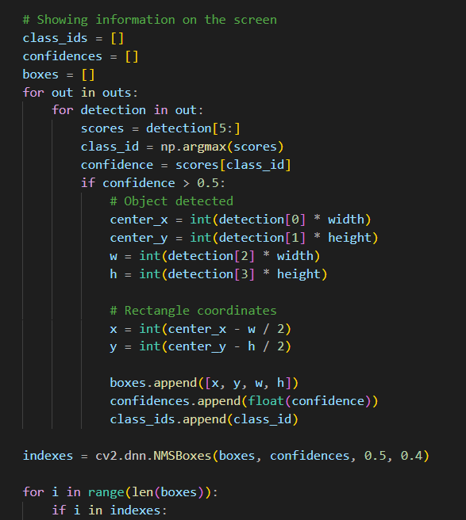
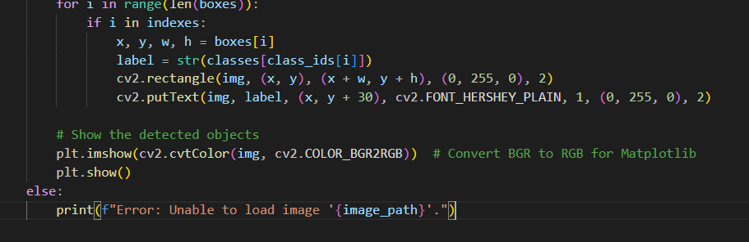
Source Code

Slide 8
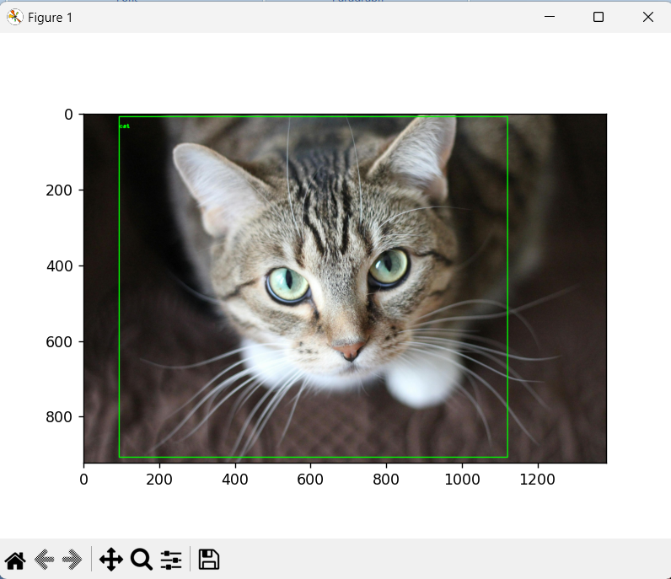
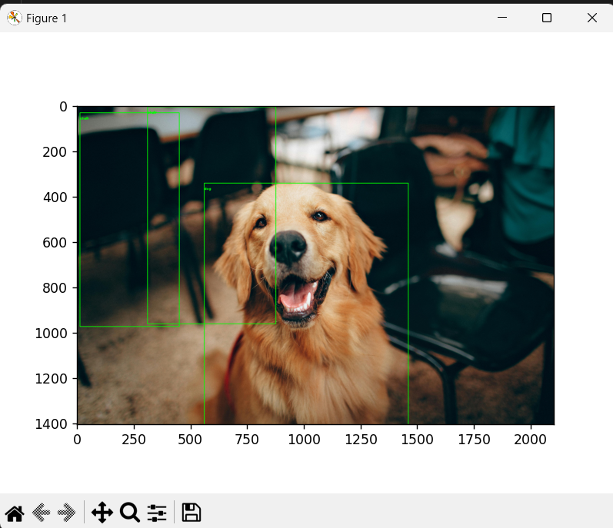
Results

Slide 9
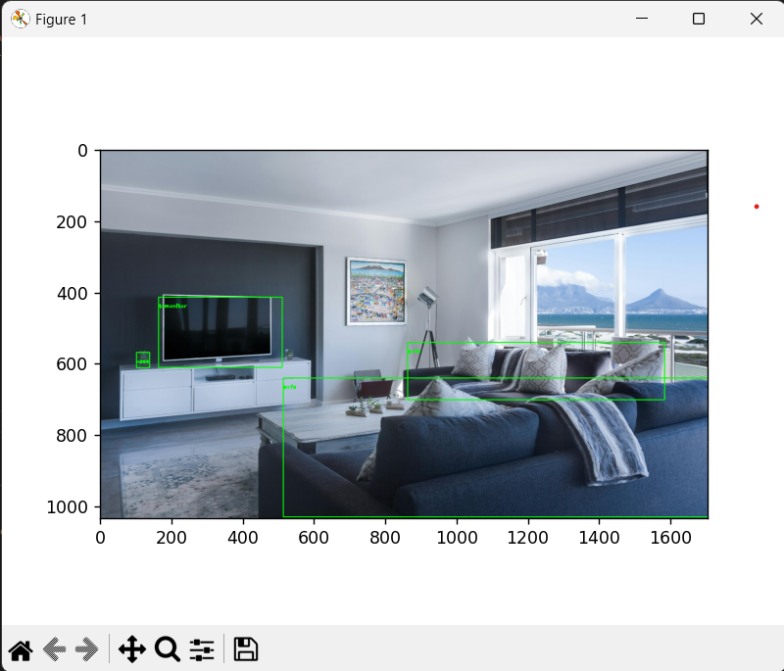
Results

Slide 10
References
https://www.kaggle.com/code/ankitp013/step-by-step-yolov3-object-detection
https://www.kaggle.com/code/aruchomu/yolo-v3-object-detection-in-tensorflow

